Slide 1
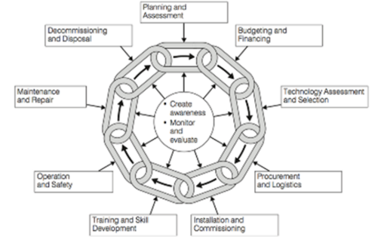
Equipment management standards across the life cycle
Acquisition
Installation and commissioning
Use
Disposal
17.5.8 Applying equipment management standards across the life cycle
Unit C 17.5 Adhering to Medical Equipment Standards
Module 279-17-C Regulations, Standards and Ethics
©
dr. Chris R. Mol, BME, NORTEC, 2015

Slide 2
Adopting Standards in hospital workshops
Without adoption of standards,
all local workers & managers do things in the way they feel themselves that is best.
Some hospital equipment workshops will be run in a better way than others, simply because some workers/managers are better than others. Some will be run more poorly, simply because…….
With the adoption of standards:
Everybody benefits from the knowledge and best practices of the best experts (in the country and/or the world).
In total, costs are reduced because not everybody has to re-invent the wheel by himself. Available resources are used better.
©
Standards across life cycle
dr. Chris R. Mol, BME, NORTEC, 2015

Slide 3
Where do Standards come from ?
The MoH can set up (regulations and/or) standards on certain topics related to equipment management
guidelines on Equipment Donations
setting up an Equipment Management Committees in each government hospital
equipment inventory format
work forms
The BioMedical Technologist’s Association of Zambia (or equivalent) can set up guidelines and ask its members to adhere to these.
A hospital can define - by itself - ‘ways of working’. That is not a standard, but could lead to one via adoption of these ‘ways’ by other hospitals.
Both MoH and BMAZ can propose/guide/regulate to adopt international standards and regulations
©
Standards across life cycle
dr. Chris R. Mol, BME, NORTEC, 2015

Slide 4
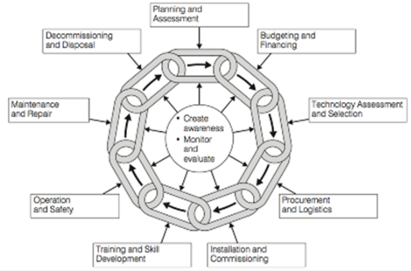
What topics are good for adopting standards?
In the following slides, the various activities around Medical Equipment Management throughout the life cycle are inspected to see what standards could usefully be adopted within the scope of this activity.
This is taken from last year’s course on Management and Maintenance of Medical Equipment as well as from MHRA and AAMI standards.
©
Standards across life cycle
dr. Chris R. Mol, BME, NORTEC, 2015

Slide 5
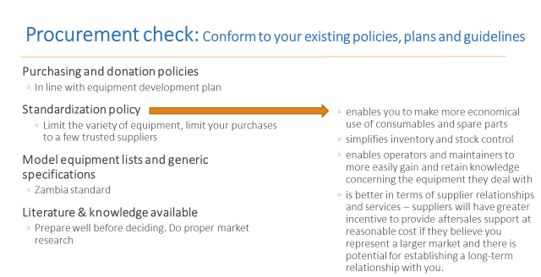
Standards in Acquisition / Procurement
National standards on Tender procedures
Standard Equipment lists (per hospital type)
Generic equipment descriptions
Standardization of preferred suppliers and/or equipment models
…
©
Standards across life cycle
dr. Chris R. Mol, BME, NORTEC, 2015

Slide 6
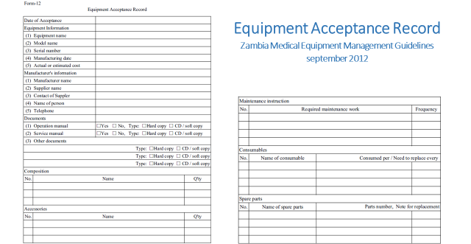
Installation and commissioning
Procedures describing acceptance testing; including communication with users on arrival of shipment and on installation
Safety Testing
Equipment Acceptance Record
©
Standards across life cycle
dr. Chris R. Mol, BME, NORTEC, 2015

Slide 7
(Initial) training of maintenance staff and users
Procedures around user training, including:
who to invite
registration who is present
repeat sessions
content of user training
etc.
©
Standards across life cycle
dr. Chris R. Mol, BME, NORTEC, 2015

Slide 8
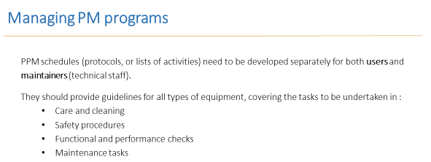
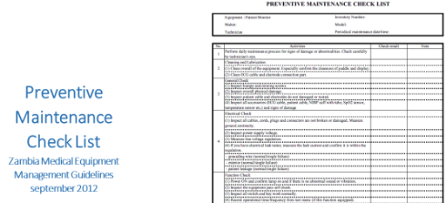
Preventive Maintenance and Calibration
There must be descriptions on what a technician needs to do when inspecting a device; per device.
Each inspection procedure must include the estimate of the time required to perform that procedure
There must be a list of (service) documents that are required for maintenance.
There must be a description on how documentation regarding equipment repair is kept/archived
Inspection intervals per equipment should be listed and verified in line with the manufacturer’s instructions and taking
A gradual way of introducing Preventive maintenance in a hospital
©
Standards across life cycle
dr. Chris R. Mol, BME, NORTEC, 2015

Slide 9
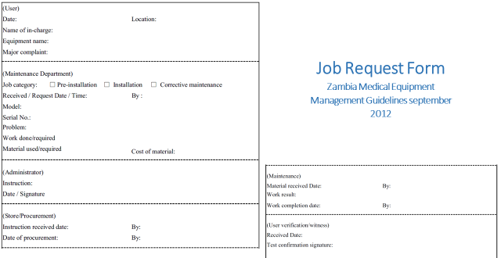
Corrective Maintenance
There must be a list of (service) documents that are required for maintenance.
There must be a description on how documentation regarding equipment repair is kept/archived
How each device should be maintained and repaired, and by whom
Arrangements to ensure items subject to inspection, maintenance, repair or disposal should be decontaminated beforehand
The time scale for repairs to be completed
Corrective maintenance forms for bookkeeping must be defined
©
Standards across life cycle
dr. Chris R. Mol, BME, NORTEC, 2015

Slide 10
Equipment Control & Asset Management (Inventory)
A hospital must maintain an equipment inventory
it must be defined what equipment goes into the inventory and what not
certain ‘fields’ are obligatory in the inventory , certain fields are optional
the inventory must be accurate – in line with reality
the inventory must be audited yearly (by checking a random selection of equipment)
There should be systems in place to ensure reporting of device issues including:
the effectiveness of the medical devices management system
the condition and performance of medical devices including: device failures and issues; utilisation, performance, maintenance; repair and calibration history
Healthcare organisations should set out a long term approach and objectives for the management of their medical devices, including strategic replacement and development equipment procurement planning.
©
Standards across life cycle
dr. Chris R. Mol, BME, NORTEC, 2015

Slide 11
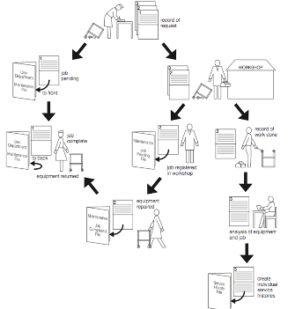
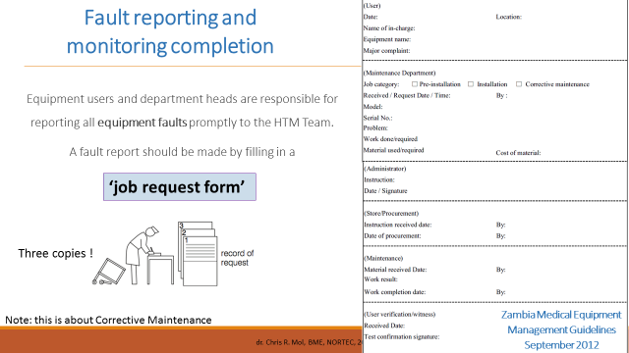
Record Keeping / work order management
©
Standards across life cycle
dr. Chris R. Mol, BME, NORTEC, 2015

Slide 12
Disposal
Decommissioning aims to make devices safe and unusable, while minimising damage to the environment.
Any device deemed unfit for use should be decommissioned.
Decommissioning should include decontamination, making safe and making unusable.
Decommissioning of device incorporating radioactive sources must be carried out in accordance with the Ionising Radiations Regulations.
If a device stores patient identifiable data, this should be certified as securely erased before disposal. Data on any device should be forensically unrecoverable, i.e. patient data must be over-written.
©
Standards across life cycle
dr. Chris R. Mol, BME, NORTEC, 2015

Slide 13
Maintenance staff and facilities
Required number of (BMET) staff should be identified, adequate for maintenance tasks
Training for each BMET is required to be at least 72 hours over a 3 year period.
Training for a new employee is at least 36 hours in the first year.
Adequate workshop space must be allocated
Space to store unused equipment should be identified
Financial management: budgets must be established
Test equipment must be defined
Healthcare organisations should establish a medical devices management group to develop and implement policies across the organisation.
©
Standards across life cycle
dr. Chris R. Mol, BME, NORTEC, 2015

Slide 14
Patient Safety and Risk Management; Accident Investigation
Incident Investigation must be executed with qualified persons
It must be defined who will report adverse incidents to what official agencies.
root cause analysis must be performed
©
Standards across life cycle
dr. Chris R. Mol, BME, NORTEC, 2015

Slide 15
END
The creation of this presentation was supported by a grant from THET:
see https://www.thet.org/

